Slide 1
progRESsHEAT
Supporting the progress of renewable energies for heating and cooling in the EU on a local level
www.progressheat.eu

Slide 2
Heat pumps
Capacity Building Material

Slide 3
Introduction
Heat pumps
The following slides give an introduction to the use of heat pumps for providing space heating and domestic hot water to buildings. This includes principles of different types of heat pumps, examples of investment and operation costs as well as advantages and disadvantages of this technology.
Target group: staff of local, regional and national administrations not familiar with the topic
Notes:
This slide is meant as background information for the presenter, not for presenting.

Slide 4
Content
Index
Introduction
Technical aspects
Types and principles
Heat sources
Efficiency
Investment and operation costs
Advantages / Disadvantages

Slide 5
Introduction
Heat pumps shift thermal energy from lower temperatures to higher temperatures or the other way round.
Thus, heat pumps can be used for heating or cooling.
Different types of heat pumps exist:
compression
absorption
rotation
Most common sources of heat used with heat pumps are
air
soil
groundwater
river and sewage water
excess heat from various sources

Slide 6
Refrigerants used in heat pumps
Fluids which are used for heat transfer in a refrigeration system and which absorbs heat at a lower temperature and pressure and emits heat at a higher temperature and pressure.
(DIN EN 378-1 Abs. 3.7.1)
Boiling temperatures of important refrigerants:
Ammonia = -33,0 °C at 1,00 bar
Hydrocarbons = -26,3 °C at 1,00 bar

Slide 7
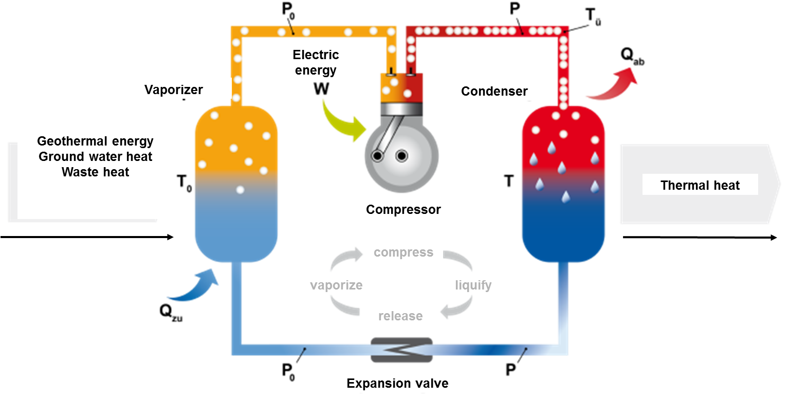
Principle of a compression heat pump
Source: CC BY-SA 3.0, EnergieAgentur.NRW

Slide 8
Principle of a compression heat pump
The refrigerant is fed with heat from an external source. This increases the temperature of the refrigerant until vaporization.
The vapour then is brought into an electric compressor increasing pressure and temperature of the vapour.
The vapour at higher pressure enters the condenser. There the refrigerant is forced to exchange part of the contained heat to a heat absorbing fluid. This leads to the condensation of the refrigerant.
The condensed refrigerant is passed through an expansion valve. This reduces the pressure and temperature to the starting conditions.

Slide 9
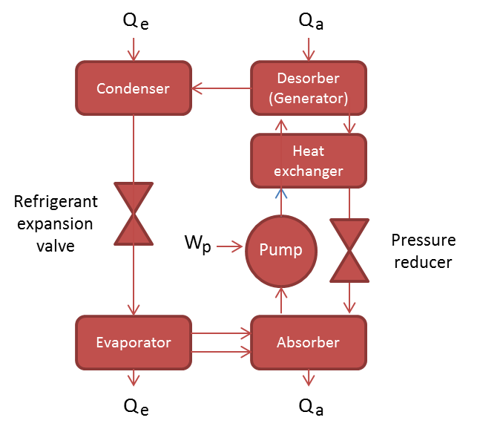
Principle of a compression heat pump
Source: Energy Engineers GmbH

Slide 10
Principle of an absorption heat pump
The refrigerant is fed with heat from an external source. This increases the temperature of the refrigerant until vaporization.
The refrigerant is absorbed in a second fluid (absorption fluid). In this step heat is released that can be used for heating.
The absorption fluid is heated until the refrigerant is desorbed again at higher temperature.
The vapour at higher temperature enters the condenser. There the refrigerant is forced to exchange part of the contained heat to a heat absorbing fluid. This leads to the condensation of the refrigerant.

Slide 11
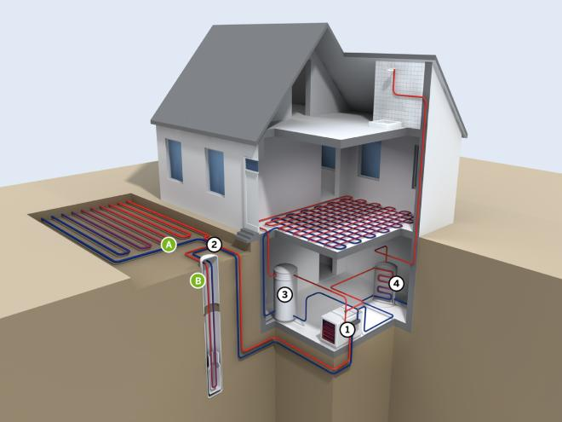
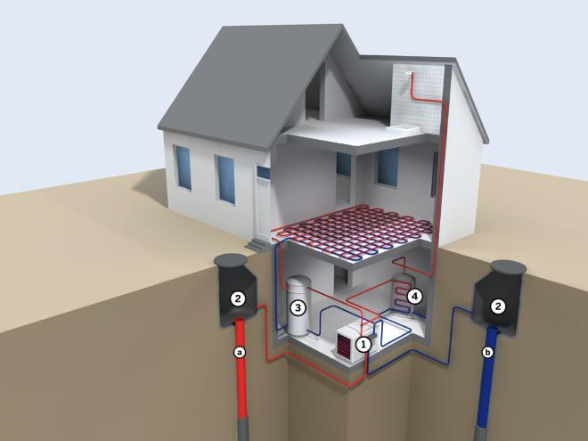
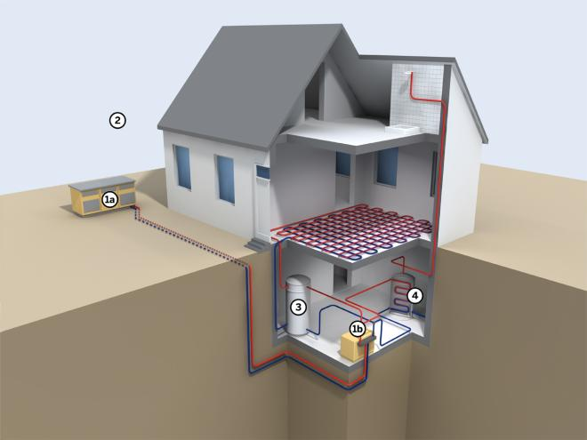
Principles of heat sources for heat pumps
Ground
water
Soil
Air
Source: CC BY-SA 3.0, EnergieAgentur.NRW
Notes:
https://setis.ec.europa.eu/system/files/Technology_Information_Sheet_Heat_Pumps.pdf

Slide 12
Heat pump using the heat in the ambient air
Heat is extracted from ambient air drawn across its heat exchanger
Source temperature will be very dependent on prevailing ambient temperature and varies through the year
Two different distribution fluids can be uesd:
Air-to-water
Air-to-air
Source: CC BY-SA 3.0, EnergieAgentur.NRW
Notes:
https://setis.ec.europa.eu/system/files/Technology_Information_Sheet_Heat_Pumps.pdf

Slide 13
Heat pump using the heat in the soil
The refrigerant gets boiled by using the heat contained in the soil
In A) the system works with an earth collector und in B) the system works with an earth explorer.
B) is more expensive than A).
Mostly water is used to collect the heat from the soil
Source: CC BY-SA 3.0, EnergieAgentur.NRW
Notes:
https://setis.ec.europa.eu/system/files/Technology_Information_Sheet_Heat_Pumps.pdf

Slide 14
Heat pump using the heat in the ground water
The refrigerant gets boiled by using the heat contained in the ground water
Ground water temperatures are nearly constant over the year
Investment costs are high compared to other heat sources due to the expenses for drilling
Water is used to collect the heat from the ground water
Source: CC BY-SA 3.0, EnergieAgentur.NRW
Notes:
https://setis.ec.europa.eu/system/files/Technology_Information_Sheet_Heat_Pumps.pdf

Slide 15
Efficiency of heat pumps (Coefficient of performance)
Heat pump | Coefficient of performance (COP)
Air-to-water | 3,2
Brine-to-water | 4,3
Water-to-water | 5,4
Source: http://www.effiziente-waermepumpe.ch/wiki/Leistungszahl_(COP)
The COP is the ratio of the heat supplied by the heat pump and the energy used to drive the heat pump
The higher the COP the more efficient works the heat pump
The COP only reflects the efficiency of the heat pump in a certain moment. Average COP values over a year are called Seasonal Energy Efficiency Ratio (SEER)
Compression heat pumps can reach COPs of up to 6
Absorption heat pumps can reach COPs of up to 1.5

Slide 16
Investment and operation costs of heat pumps
Heat pump | Investment costs | Operation costs
Air-to-air | 1300 €/kW | 1200 €/p.a.
Air-to-water | 2000 €/kW | 1250 €/p.a.
Brine-to-water | 2700 €/kW | 700 €/p.a.
Water-to-water | 3000 €/kW | 550 €/p.a.
Source: https://www.heizsparer.de/heizung/heizungssysteme/waermepumpe/waermepumpen-kosten
The investment costs for ground water-to-water heat pumps are the highest due to the additional costs for the drilling
Air-to-water and air-to-air heat pumps have the highest maintenance costs because of constant refrigerant controls
The operation costs are based on the costs for maintenance
The investment costs are getting lower the higher the capacity gets
Notes:
assumptions in the calculation of the investment and operation costs: electricity price is 20 c€/kWh, heat demand to be supplied yearly is 15 – 20 MWh, capacity of heat pump is 10 kW

Slide 17
Advantages / disadvantages of heat pumps
Advantages
High efficiency
No local emissions
Low operation costs
Low dependency on energy prices
Reduction of the energy consumption
Use of low grade heat contained in air, water, ground and excess heat from various sources
Reliable and low-maintenance technology
Disadvantages
High investment costs compared to other heat supply systems
High efficient use of the heat pumps is only possible for low flow temperatures in the heat distribution system
Possible auxiliary heater in cases where no low temperature distribution system is installed / installable
Temperature of the heat source is only constant with water source heat pumps

Slide 18
Thank you for your attention!
www.progressheat.eu

